Slide 1


Slide 2

National Hispanic Heritage Month, which begins in the United States each year on Sept. 15 - Oct. 15! It started as a week then it was expanded to a month in 1988.
The celebration begins in the middle of September to coincide with independence days in several Latin American countries.

Slide 3
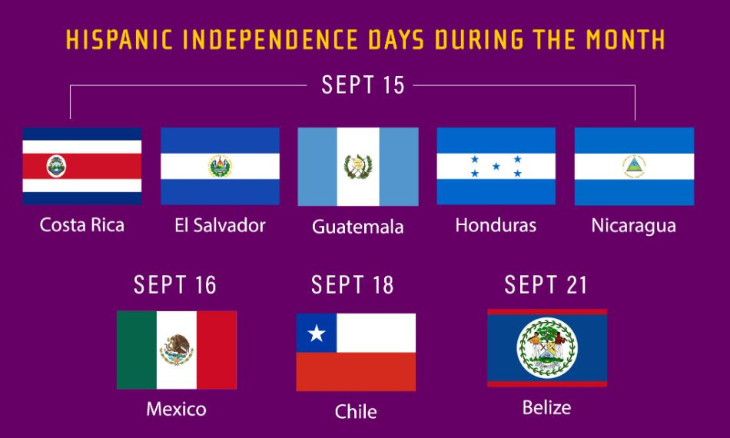

Slide 4


Slide 5
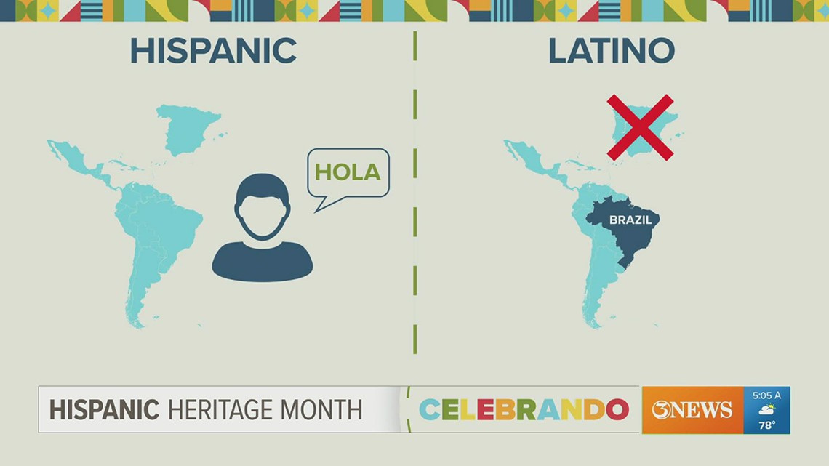

Slide 6
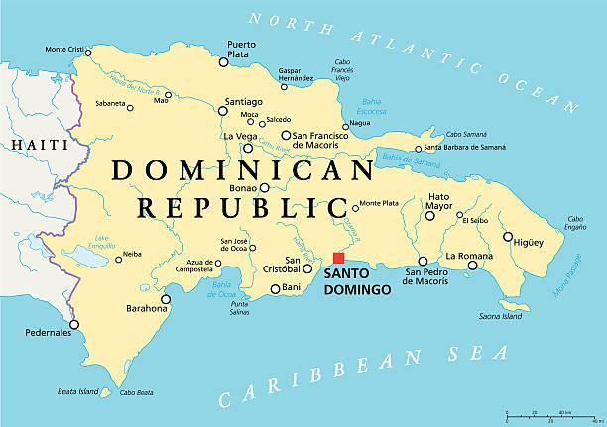
Today’s Focus

